Slide 1
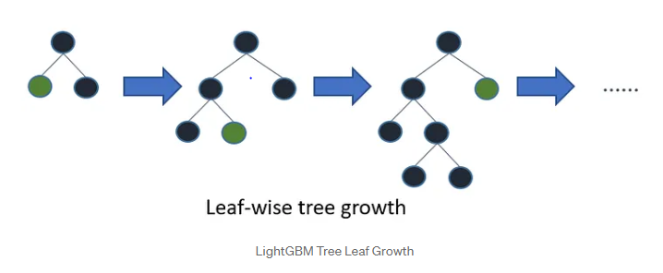
LG Boost Algorithm
LightGBM is a gradient boosting framework that uses tree-based learning algorithms. It grows the tree Leaf Wise while other algorithms grow level wise.

Slide 2
Different Algorithms Supported by LightGBM
Gradient Boosting Decision Tree (GBDT)
Gradient-Based One-Side Sampling (GOSS)
Exclusive Feature Bundling (EFB)
Histogram-Based Learning
DART (Dropouts meet Multiple Additive Regression Trees)

Slide 3
Efficiency and Speed Advantages of LightGBM
Innovative techniques are used to improve the memory usage and training time
Leaf wise tree growth
Histogram based algorithms
Parallel and GPU Learning
Sparse Data Handling

Slide 4
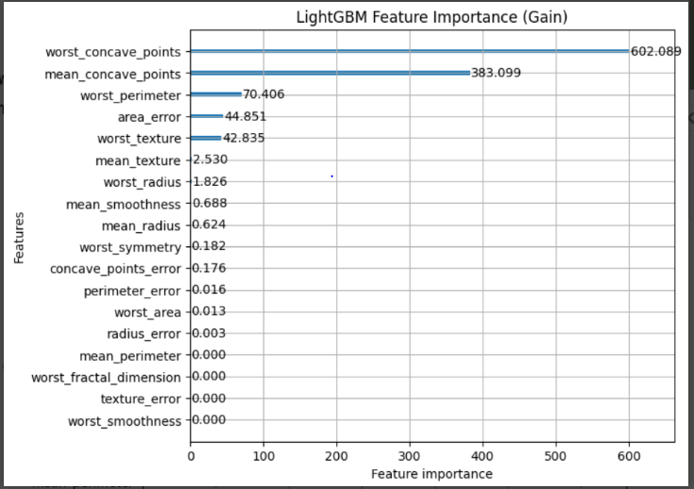
LightGBM Feature Importance and Visualization
LightGBM provides two main types of feature importance scores: “Split” and “Gain.”

Slide 5
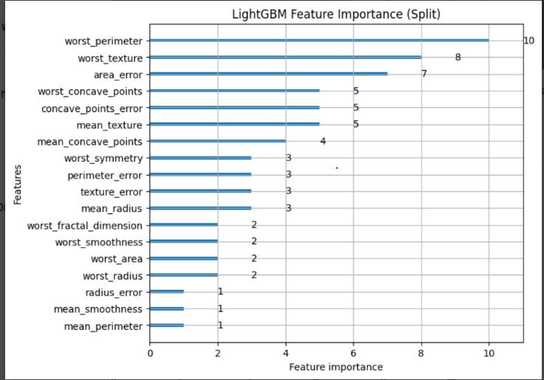
LightGBM Feature Importance and Visualization

